Slide 1

Green Pace
Security Policy Presentation
Developer: Andrew Kuhn

Slide 2

OVERVIEW: DEFENSE IN DEPTH
This security policy has been developed to increase product security, by including best practices, following coding standards and procedures.

Slide 3
THREATS MATRIX
Likely Most likely to occur | Priority High severity/High Remediation costs
Low priority Low severity/Remediation costs | Unlikely Less likely to occur
This threat matrix shows the on a table the difference between likely/unlikely and low/high priority issues that can occur.

Slide 4
10 PRINCIPLES
Validate Input Data – Data Type, Data Value, Integers
Heed Compiler Warnings – Data Type, Data Value, String Correctness
Architect and Design for Security Policies – Data Value, Memory Protection
Keep it Simple – Data Type , String Correctness, Exceptions, Integers
Default Deny – Input/Output, Environment
Adhere to the principle of Least Privilege – SQL Injection
Sanitize Data Sent to Other Systems– SQL Injection, Assertions
Pracitce Defense in Depth – SQL Injection, Memory Protection, Assertions
Use effective quality Assurance Techniques – Memory Protection, Assertions, Environment
Adopt a Secure coding standard – SQL Injection, Memory Protection, Assertions, Environment

Slide 5
CODING STANDARDS
Integers – High Severity – Likely
Memory Protection – High Severity – Likely
SQL Injection – High Severity – Likely
String Correctness – High Severity – Unlikely
Data Value – Medium – Probable
Data Type – Medium - Probable
Exceptions – Low – Likely
Environment – Low Severity – Probable
Input/Output – Low Severity – Probable
Assertions – Low - Unlikely
I have ordered these in prioritization based the level of severity, and how likely an issue is to occur.

Slide 6
ENCRYPTION POLICIES
Encryption in rest | Encryption in rest means when data is stored on disk, the data is encrypted. If a hacker was able to acquire the encrypted data, but no encryption keys. It is very unlikely the hacker would have any usable data.
Encryption at flight | Encryption at flight means that while data is being transmitted, the data is encrypted. This provides protection to the data if for some reason it is intercepted or goes to an incorrect place.
Encryption in use | Encryption in use would be using encrypted passwords that are hashed to perform password verification.

Slide 7
TRIPLE-A POLICIES
Authentication | Authentication is the process of verifying a user, this is for user login and addition of new users.
Authorization | Authorization is to verify the level of user access. This is designed to deny the user unless the user has given permissions. This is for User level of access.
Accounting | Accounting is to keep a control of what changes are being made and where. This is used for changes made to the database and which files are accessed by different users.

Slide 8
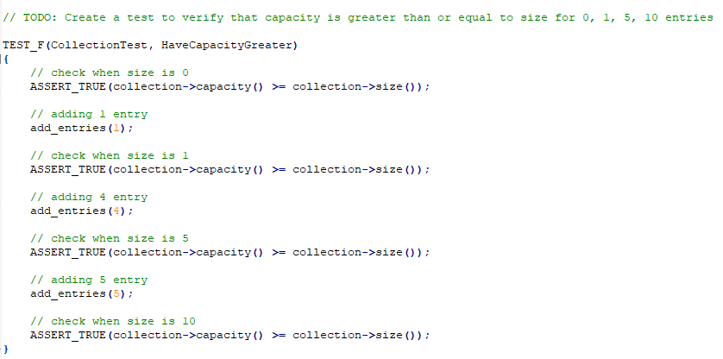
Unit Testing
I chose to test the capacity of entries.

Slide 9
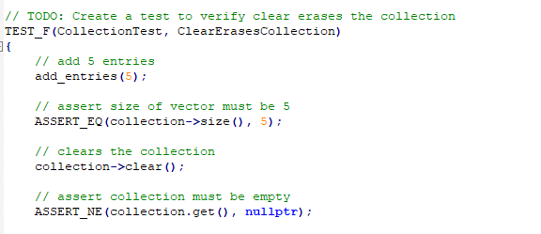
Unit Testing
This test verifies that clear erases the collection.

Slide 10

AUTOMATION SUMMARY
Security tools reside in nearly every piece of the flow in automation. Security is something that should be thought about in every step. If security is left out of any step, the risk of breaching security will grow exponentially.

Slide 11
TOOLS
The DevSecOps is putting security into the software development lifecycle.
Different tools that can be used are, SAST tools which will perform automated scans of your code to identify security risks.
Another tool that can be used is a DAST tool, which focuses on the logic used within your code and live data to find possible security issues.

Slide 12
RISKS AND BENEFITS
Problems – When a security issue is found, is it more financially reasonable to address the problem when its found? Or wait until this issue gets larger?
Solutions – Depending on the problem, solutions could be to re write code or to introduce more layers of security
Risks/Benefits – This is determined based on risk/reward. It will cost money to solve a problem now, which could never be a big problem. But if you wait, and the issue turns into a major security breach it could become much more costly than fixing it originally.

Slide 13
RECOMMENDATIONS
Maintain the keep it simple method. If code gets too complex, more problems are likely to arise.
Test early and often
Check security before new code is deployed
Automate testing

Slide 14
CONCLUSIONS
The coding standards that have been listed in this documentation should be followed by every developer. By not following these standards, the company will be placed at a high security risk. Real world examples of this not being solved can be found by major security breaches such as the LinkedIn platform. Simple mistakes can lead to major problems, with the necessary testing and tools that are easily available. Security breaches can be avoided.

Slide 15
REFERENCES
[Provide APA-style references with links to resources, articles, and videos that you used in your presentation.]

